Slide 1
BAT Customer Voice
Introduction

Slide 2
What we are going to cover today
1
Introduction to Customer Voice
2
2
Qualitative Guidelines
3
3
Quantitative Guidelines
4
4
Next Steps

Slide 3
Introduction to Customer Voice

Slide 4
Customer Voice places the retail customer at the heart of BAT’s strategy
An ongoing dialogue with customers to explore and understand issues and concerns for mutual business benefit
The programme will:
Create a channel for retail customers to provide feedback for BAT to act upon
Assess the satisfaction and relevancy of service provided by BAT
Identify areas of opportunity and of lower performance to follow up on
Encourage and drive End Market action planning with multi-function collaboration

Slide 5
When should Customer Voice be carried out?
Customer Voice is not a mandatory research programme, BUT it is:
Expected for T15 markets on an annual basis
Recommended for markets with major changes affecting customer engagement
The findings from Customer Voice will be a major input to the TM&D agenda to drive multi-function actions
Actions derived from the Customer Voice programme should be communicated back to customers

Slide 6
Customer Voice has been developed to provide an in-depth understanding of BAT’s customers
Comprehensive qualitative interview programme, covering full range of BAT customers
Explore and understand the key issues of BAT’s customers
Develop more relevant and meaningful activities, action plans and opportunities for collaboration
Optional quantitative element to provide robust market-level data
A point in time measurement of BAT’s performance on key indicators
Track changes in performance over time
Note: Customer Voice has been set up as a local to local research Programme – there is no central co-ordination

Slide 7
Customer Voice – roles and responsibilities
End Market TM&D
End Market SP&I
Local co-ordinating agency
Project Owner
Confirm project scope
Confirm survey specification
Provide sample
Approve qualitative discussion guide (and quantitative questionnaire if taking place)
Brief research agency
Obtain and review proposal
Approve methodology and research design
Finalise discussion guides/questionnaire
Obtain all local legal & CORA approvals
Liaise with research agency throughout the project
Provide proposal for agreed programme specification
Select sample
Conduct qualitative interviews (and quantitative where necessary)
Produce all agreed deliverables

Slide 8
Qualitative Guidelines

Slide 9
The qualitative engagement will deliver a number of benefits
Capturing factors that inform attitudes and perceptions
Respondents’ beliefs/attitudes, perceptions, experiences and needs will be fully explored. This will allow a fuller understanding of what drives customers’ opinions about the ‘BAT experience’
Attaining breadth and depth of insight
BAT will have a richer understanding of the general retail landscape, and the specific opportunities and challenges being encountered by their customers. This learning will prove useful in developing more targeted and meaningful strategies
Direct contact across the customer base
The fieldwork, which will be carried out via a face-to-face approach, will engage a wide cross section of BAT client accounts. By taking part, respondents will recognise the value BAT places on listening and learning from its customers

Slide 10
Strategic framework: key to the success of qualitative strand
The strategic and tactical needs of each BAT market will differ depending on factors such as the size of the business and current client account base. In order to ensure full alignment with local realities, BAT and the co-ordinating agency need to collaborate throughout to:
1
Identify key strategic and tactical priorities – both current and future
2
2
Map the account universe to finalise the sample to be engaged
3
3
Select the most appropriate and meaningful set of questions to include

Slide 11
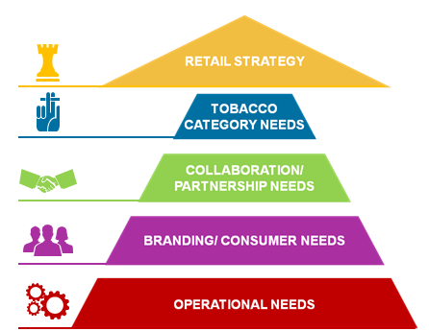
A needs based framework to guide strategic planning
Customer Voice is underpinned by a needs-based pyramid framework, devised by Global TM&D.
It represents all the potential business interactions that take place between retailers and BAT, and should be the basis for identifying priorities.

Slide 12
Qualitative methodology
The research will be carried out via in-depth interviews, which will:
Format
Be conducted face-to-face
Duration
Last approximately 1 hour
Location
Be conducted at a location that is convenient for the respondent
Practical tips:
1) Focus groups will not deliver the detailed and unbiased response required from each respondent
2) When carrying out interviews at a respondent’s place of work (e.g. a shop) be prepared for possible interruptions!

Slide 13
Sample design
Customer needs and perceptions vary depending on the size of the business and individual respondent’s role and remit. To ensure a broad representation of customer views, recruitment needs to reflect each tier - T1, T2 and T3 - of BAT business
T1: Key accounts, senior management
T2: Mid-sized accounts, mid management
T3: Independents
Who: Largest customers in each market
Examples: Large supermarket chains (Tesco), convenience stores (7-11) and petrol stations (Shell)
Target respondents: GM / Director level (e.g. Director of Trade)
Who: Smaller than key accounts but well-known locally
Examples: Medium sized chains, HORECA and distributor/wholesalers
Target respondents: Senior Managers (e.g. Merchandising Manager)
Who: Independent retailers with one or more outlets
Examples: Convenience stores, kiosks and cafés
Target respondents: Owners and managers

Slide 14
Sample development
A total of 30 interviews is recommended to pull out similarities and differences. However, we advise that you use the following steps to identify the most appropriate number for your market:
Key requirements
2
Target audience
Market makeup
Budget
1
2
3
4
What are the key questions and issues that you want to address?
What are your priorities for the market and the accounts that you service?
Who would be the best people to answer your key questions?
How many of these people would provide the required detail?
What is the size and structure of your market?
How are they divided across the tiers?
Which ones are most relevant to your research objectives?
How many interviews can be commissioned without compromising quality?
Practical tip:
Effective collaboration across these steps between BAT and the co-ordinating agency will assist greatly in identifying the best sample mix

Slide 15
Sample development – two hypothetical examples
Country X: Market context
Recommended sample:
30 interviews: would allow a good mix of retailers and aid comparisons across different tiers
Tobacco is sold through various channels across the three tiers.
Tobacco regulations, depending on the type of store, also exist
Country Y: Market context
Recommended sample:
15-20 interviews: would allow geographic spread, and help outlining differences between customers
Tobacco can only be sold in licensed tobacconists (T3). As all outlets conform to strict guidelines, they are very similar

Slide 16
Recruitment process: a step by step guide
1. BAT will identify and provide a random sample pool
2. To complete 30 interviews, a minimum sample of 50 is required
5. Additional batches of sample can be requested once initial sample pool has been exhausted
4. Assumed interviews will be conducted in local language: if not, the co-ordinating agency will advise on implications
3. The co-ordinating agency will recruit respondents
Practical tip:
We recommend over recruiting as this will help account for any drop outs
2) Pick a range of respondents to make sure all kinds of views – positive and negative – are included

Slide 17
Discussion guides
With respondents ranging from General Managers to Sales Assistants, the discussion guide will play a vital role in facilitating tailored and meaningful conversations:
Three separate guides
Three one hour discussion guides have been developed by TM&D for each BAT tier:
T1&2 - strategic focus
T3 - operational focus
Wholesale & distributor - trade focus
The questions in the guides have been piloted and are there as an aid. These guides should be viewed as templates, which will need to be adapted to fully suit local needs.
For example: You may want to replace questions that are not suitable for your market and/or add new ones for areas that are not covered fully
A template
Importance of working together
When developing the discussion guides BAT and co-ordinating agency should work together to pick questions that address key strategic issues

Slide 18
Discussion guide development
1
Core questions
2
5 key themes to build on
3
Tailoring the ideal guide
Two “core” introductory questions are compulsory:
What are the key challenges you are facing /what keeps you awake at night?
What are the challenges you see for your tobacco category? Why?
Five key themes which cover the key needs of the retailers:
Operational needs
Branding/consumer needs
Collaboration/partnership needs
Tobacco category needs
Retail strategy
Country specific questions can be included as long as these are relevant to Customer Voice
It will not be possible to cover all 5 themes in depth in each interview. You should focus on 2 or 3 that fit the business issues and respondent type.
For example, it would not make sense to cover retail strategy with a T3 respondent running a single outlet
Practical tip:
1) When selecting questions for the guides, think about what is needed from the research: for example, what are the key challenges/concerns facing your business or what are your competitors doing?

Slide 19
Analysis and deliverables
1
A standard analysis framework containing the core questions has been provided . Any additional questions will need to be incorporated into this
2
2
A standard reporting template (PowerPoint), covering the core questions, has also been provided
3
3
The analysis will take 2 weeks to complete
4
4
BAT should decide how it wants to receive the results. We recommend a face-to-face debrief presentation

Slide 20
Quantitative Guidelines

Slide 21
Quantitative survey provides a representative, point-in-time measure of BAT performance
Benefits of conducting a quantitative survey
Representative of all outlets, across all major channels
Robust measure of overall satisfaction (Customer Engagement Index)
Ratings on key aspects of customer relationship with BAT
Identify areas of lower performance
The quantitative survey is optional within the Customer Voice programme

Slide 22
Cost-effective, appropriate methodology
Optimum methodology for End Market
Interviews conducted by telephone wherever possible
High level of respondent involvement via personal interview
Interviewing conducted by trained interviewers from a bona fide market research agency
Interviews can be conducted face-to-face where telephone not possible

Slide 23
Efficient survey design; independent, representative sample selection
Standard design
Analysis at total, End Market level
Minimum sample size of 200, spread across all channels
Non-standard design
Analysis by sub group (eg. geographies and channels) can be added if required (additional cost and timing)
Minimum sample size for any sub group is 100
Sampling
Trade customers who have direct contact with BAT
BAT to provide agency full database - no “pre-selection”
Agency selects random sample of customers for interview
Quotas will not be set on channel or geographic region, unless sub group analysis is required

Slide 24
Questionnaire – applicable to all customers, focused on key measures
Standard design: 10 minute interview
Non-standard design: Additional local questions can be added at extra cost
Topic area | Purpose
Screener | To ensure we are speaking to the decision maker within the business
Brands stocked and contact with suppliers | Check products are stocked and that there is direct contact with BAT
Customer Engagement Questions | Calculate the Customer Engagement Index to benchmark overall performance of BAT (and other tobacco & FMCG suppliers, if applicable).
Performance ratings on key metrics | How does BAT perform on key areas? What are the areas for improvement?
Relationship with BAT | Understand what outlets are looking for from their relationship with BAT
Product delivery issues | Is there a problem with the condition of products delivered by BAT?
Demographics | Profile of the trade outlets
Note: Co-ordinating agency responsible for translation of English questionnaire (translation must be approved by SP&I and TM&D)

Slide 25
Calculating the Customer Engagement Index
Four questions that measure the level of customer engagement with BAT
Overall performance
Recommend suppliers’ products to associates or acquaintances?
Continue to use the products and services of suppliers?
Advantage of dealing with named supplier rather than any other?
Customer Engagement Index derived and benchmarked against database norms
Can also be asked for competitors (optional)
Note: Only TNS can calculate the CEI
If local agency is not TNS, CEI can be calculated by TNS, for an additional fee. This option can be discussed with the local Kantar contact

Slide 26
Analysis process
Data entry
Fieldwork agency conducts data entry of the questionnaires
No open-ended questions, so no coding required
Weighting
Data weighted by channel (and other subgroups such as region, if applicable) to ensure results are representative of the total BAT trade universe.
Data is weighted to represent the proportion of the number of outlets

Slide 27
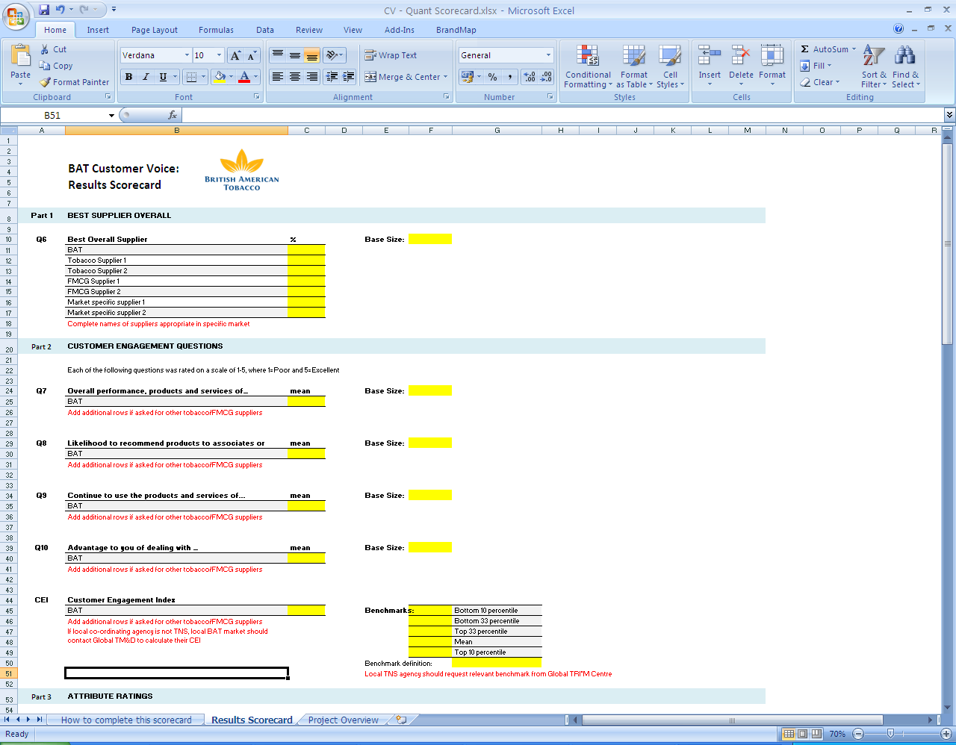
Simple, easy to understand deliverables produced by co-ordinating agency
Standard design
Excel scorecard of key metrics including CEI score
Data tables for all questions
Results provided at total, End Market level
Non-standard design
Results provided by sub-group (if sample size was specifically increased to allow for sub-group analysis)
Additional analysis or a face to face presentation available from co-ordinating agency, at extra cost
Note: No global or regional analysis, or comparison between End Markets will be provided as part of the standard programme.

Slide 28
Next Steps

Slide 29
Next steps – BAT teams
1
Complete PIB – briefing template supplied
2
Set up meeting with co-ordinating agency to discuss recommended approach,
Decide whether just qual, or qual and quant
2
3
3
Obtain proposals and costing
4
4
Commission project (PO)
5
Agree timings for set up and project start
Typically, a standard project will take some 12 weeks to complete

